Slide 1

Superstore Sales Insights
Project Overview:
Objective:
The objective of the Superstore Sales Insights Project is to contribute to the success of the business by utilizing data analysis techniques, specially focusing on time series analysis. The project aims to provide valuable insights and accurate sales forecasting.
Description:
The project comprises several key components:
● Dashboard Creation: The project commences with the identification of Key Performance Indicators (KPIs). It involves the design of an intuitive and visually appealing dashboard with interactive visualizations and filtering capabilities. This allows users to explore the data at various levels of granularity.
● Data Analysis: The project delves into providing valuable insights to business entities regarding the effectiveness of their sales strategies. This is achieved through data visualization and charts.
● Sales Forecasting: The historical data is leveraged, and time series analysis is applied to generate sales forecasts for the next 15 days.
● Actionable Insights and Recommendations: The ultimate goal of this project is to deliver valuable insights and actionable information that can drive strategic decision-making and support the supermarket's goals for growth, efficiency, and customer satisfaction.

Slide 2
Dataset Overview:
The project incorporates data analysis techniques, specializing in time series analysis, to deliver valuable insights, accurate sales forecasting, and the creation of an interactive dashboard aimed at driving business success.
Key Findings:
● Sales by Category: The sales distribution across categories reveals that Office Supplies account for $0.64 million, closely followed by Technology at $0.47 million and Furniture at $0.45 million.
● Sales by Subcategory: Subcategory analysis demonstrates that Phones lead with $0.20 million in sales, followed by Chairs at $0.18 million, Binders at $0.17 million, and Storage at $0.15 million.
● Sales by Ship Mode: Shipping mode analysis indicates that Standard Class shipping leads with $0.91 million, followed by Second Class at $0.31 million, First Class at $0.24 million, and Same Day at $0.10 million.
● Sales by Month: Monthly sales distribution provides insights into revenue patterns throughout the year.
● Sales and Profit by State: The analysis highlights variations in profitability by state.
● Profit by Month: The project identifies monthly profit trends, ranging from -$10,000 to $20,000.
● Sales by Segment: Segment analysis reveals that Consumer accounts for 48%, Corporate for 33%, and Home Office for 19% of total sales.

Slide 3
● Sales by Payment Mode: The data shows that Cash on Delivery (COD) represents 43% of sales, followed by Online payments at 35%, and Credit Cards at 22%.
● Sales by Region: Sales distribution across regions is as follows: West - 33%, East - 29%, Central - 22%, South - 16%.
● Sales Forecast: The time series analysis results in a sales forecast for the next 15 days, which can guide inventory and resource management.
● Sales by Category in Major Cities: The sales breakdown by category in major cities provides a comprehensive understanding of product popularity in different urban areas
Conclusion:
The Superstore Sales Insights Project has successfully achieved its objectives by providing valuable insights into sales trends and forecasting. The interactive dashboard and visualizations enable informed decision-making. This project stands as a testament to the potential of data analysis in driving business growth, enhancing efficiency, and improving customer satisfaction.

Slide 4
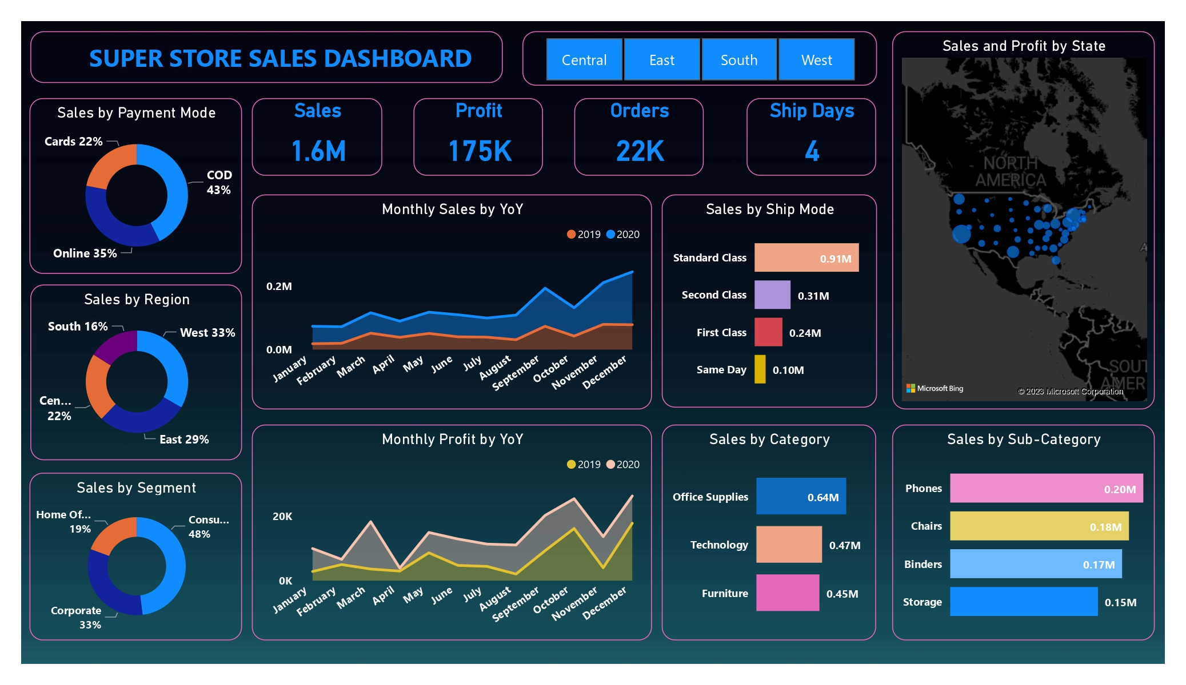

Slide 5
